Slide 1
Poetry Unit Part Two
Shelley’s “To a Skylark” and Romantic Poetry

Slide 2
“To a Skylark” (published 1820)
Celebration of nature
Spontaneity of feelings put into verse
Optimistic poem
Inspired when Percy and Mary Shelley were taking a walk in Italy
Representative of romantic poetry’s admiration for the natural world and the desire to use nature as a mirror for man’s image

Slide 3
“To a Skylark” Key Terms to Know
Lyric Poem
Metaphor
Simile

Slide 4
Lyric Poem
Originally a composition meant for musical accompaniment.
The term refers to a short poem in which the poet, the poet’s persona, or another speaker expresses personal feelings. See Robert Herrick’s “To Anthea, who May Command Him Anything,” John Clare’s “I Hid My Love,” Louise Bogan’s “Song for the Last Act,” or Louise Glück’s “Vita Nova.”
Note how the rhythm of the poem has a series of short beats in 5-line long stanzas

Slide 5
Metaphor
Definition: A comparison that is made directly (for example, John Keats’s “Beauty is truth, truth beauty” from “Ode on a Grecian Urn”) or less directly (for example, Shakespeare’s “marriage of two minds”), but in any case without pointing out a similarity by using words such as “like,” “as,” or “than.”
Think of a metaphor from Frankenstein or Dubliners

Slide 6
Simile
The explicit comparison of two objects/phenomenon/states etc - by employing either 'as' or 'like’
A comparison (see Metaphor) made with “as,” “like,” or “than.” In “A Red, Red Rose,” Robert Burns declares: O my Luve is like a red, red rose That’s newly sprung in June; O my Luve is like the melody That’s sweetly played in tune. “What happens to a dream deferred?” asks Langston Hughes in “Harlem”: Does it dry up like a raisin in the sun? Or fester like a sore— And then run? Does it stink like rotten meat? Or crust and sugar over— like a syrupy sweet?

Slide 7
How many similes do you find in the poem?
Higher still and higher
From the earth thou springest
Like a cloud of fire;
The blue deep thou wingest,
And singing still dost soar, and soaring ever singest.

Slide 8
In the golden lightning
Of the sunken sun,
O’er which clouds are bright’ning,
Thou dost float and run,
Like an unbodied joy whose race is just begun.

Slide 9
What is the meaning of the simile and the metaphor in these two stanzas?
Simile
Metaphor
The pale purple even
Melts around thy flight;
Like a star of heaven
In the broad daylight
Thou art unseen, but yet I hear thy shrill delight,
Keen as are the arrows
Of that silver sphere
Whose intense lamp narrows
In the white dawn clear
Until we hardly see—we feel that it is there.

Slide 10
Series of Similes in the Poem
#1 Simile: Skylark is like a poet
Like a poet hidden
In the light of thought,
Singing hymns unbidden,
Till the world is wrought
To sympathy with hopes and fears it heeded not:

Slide 11
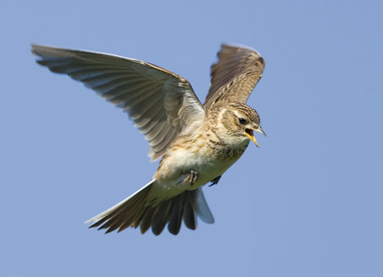
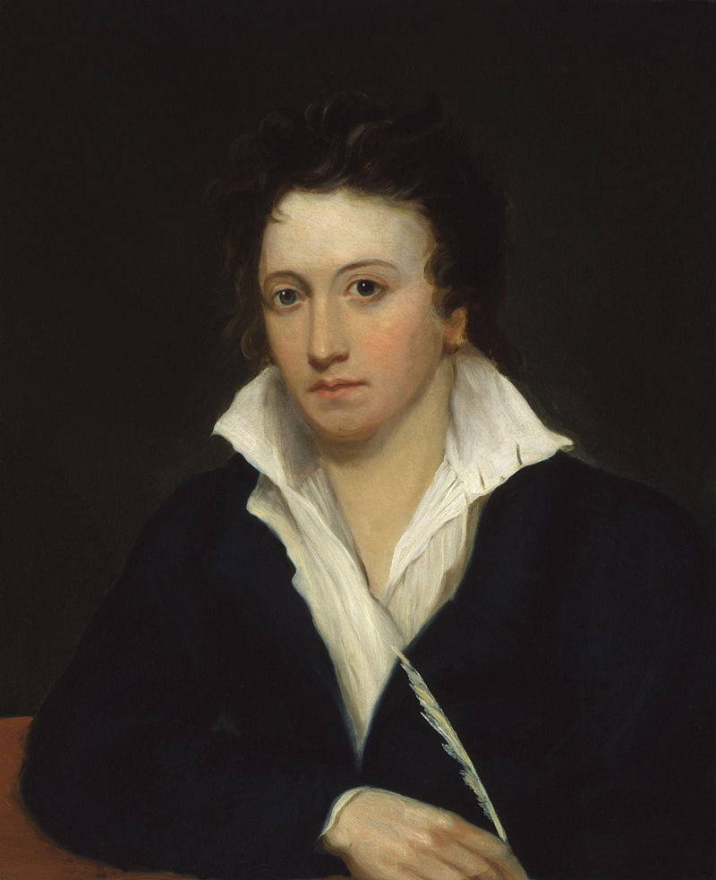
What is the connection between the skylark and the poet?
Skylark
Poet

Slide 12
Simile #2: Skylark is like a maiden
Like a high-born maiden
In a palace tower,
Soothing her love-laden
Soul in secret hour
With music sweet as love, which overflows her bower:

Slide 13
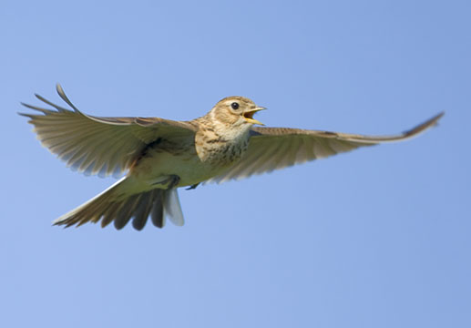
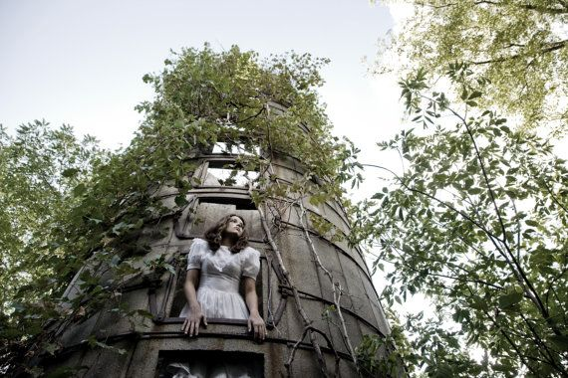
What is the connection between the bird and the maiden?

Slide 14
Simile #3: Skylark is like a glow-worm
Like a glow-worm golden
In a dell of dew,
Scattering unbeholden
Its aerial hue
Among the flowers and grass, which screen it from the view:

Slide 15
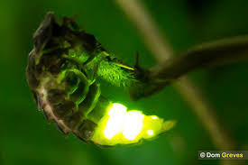
Why does poem connect bird to glow-worm?
Skylark
Glow-worm

Slide 16
Simile #4: Skylark is like a rose…
Like a rose embowered
In its own green leaves,
By warm winds deflowered,
Till the scent it gives
Makes faint with too much sweet these heavy-winged thieves:

Slide 17
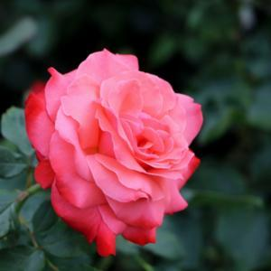
Why is this rose connected to the bird?

Slide 18
Thoughts on “Ozymandias” and “To a Skylark”
Extremely different poems in terms of their moods and tones
Describe the speakers from both poems in your own words

Slide 19
Next Time
Quiz
Lecture on Lord Byron, Keats, and Shelley
Read “Ode on a Grecian Urn” (BB)

